Slide 1
WELCOME
Let's walk you through our ideas

Slide 2

Online Shop Management System

Slide 3
PRESENTED TO
MD. Azmat Ali
Lecturer
DEPT OF CSE
HABHIT
PRESENTED BY
Tayeb Ahmed
Id: 09
DEPT OF CSE
HABHIT
Taskin Tabassum
Id: 26
DEPT OF CSE
HABHIT
Noushin Tabassum
Id: 03
DEPT OF CSE
HABHIT
Nahid Miah
Id: 32
DEPT OF CSE
HABHIT

Slide 4







Outlines
Abstraction
Case Diagram
Requirements
Data Flow Diagram
Features
E-R Diagram

Slide 5
Abstraction
01
Develop an easy-to-use platform
Improve customer experience
Develop a centralized platform
Secure user authentication system
Integrate a reliable payment gateway
Ensure data security
02
03
04
05
06

Slide 6
Requirements
Functional
Software
Non-Functional

Slide 7
Functional
Requirements
Non-Functional
Software

Slide 8
Requirements
Functional
Non-Functional
Admin & customer login system
Add, update, delete products
View products and add to cart
Manage orders
Track product
Generate simple sales reports
Command-line or GUI interface
Data persistence using file I/O
Error handling
Efficient data structure

Slide 9

Requirements
Software
C++ Compiler
IDE or code editor
File system for storing data
Graphics or GUI library

Slide 10
Features
User Authentication
Product Management
Inventory Management
Order Management
Shopping Cart System
Payment Simulation
Sales Reporting
Product Search and Filter
Rating System
Data Storage

Slide 11
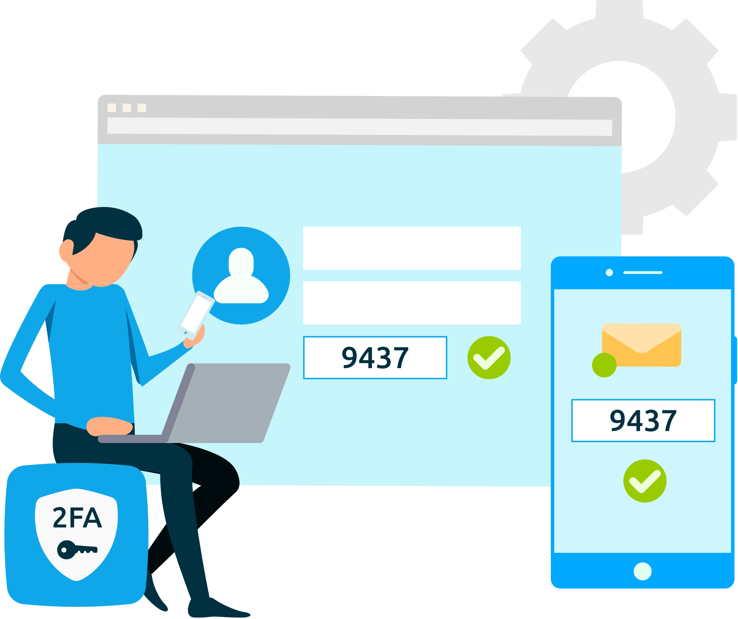
User Authentication
Sign in
E-mail
Password
contd…

Slide 12

Product Management
contd…

Slide 13
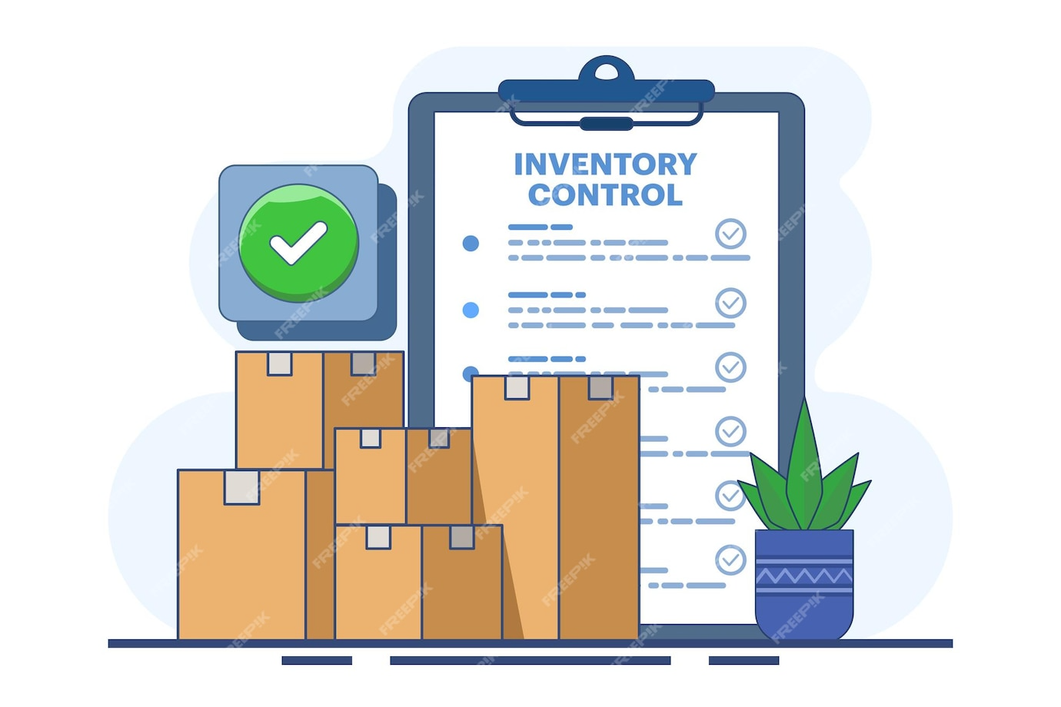
Inventory Management
contd…

Slide 14

Order Management
contd…

Slide 15

Shopping Cart System
contd…

Slide 16

Payment Simulation
contd…

Slide 17

Sales Reporting
contd…

Slide 18

Product Search & Filter
contd…

Slide 19

Rating System
contd…

Slide 20

Data Storage

Slide 21
Case Diagram
Registered Customer
Log in / Sign up
Rating
User/Service Authentication
Products
Admin
Check out
Order
New User
Payment Service

Slide 22
Data Flow Diagram
Customer
View Products
Place Orders
Database
System
Order Status
Order Confirmation
Data / Information
Inventory Update
Reports
View Orders
Admin
Manage Products

Slide 23
E-R Diagram
Rating
Product
Price
Product
Status
Admin id
Admin Name
Admin
Manage
Product
Category
Has
Product
Details
Admin Role
Category
id
Category
Name
Product
id
Product
Name
Contain
Customer
Make
Order
Has
Tracking
Info
Customer id
Contact Number
Order No
Order
Amount
Tracking
no.
Courier
Name
Customer
Name
customer
Address
Order
Date

Slide 24
Conclusion
This project will help manage an online shop more easily.
It includes features like login, product search, order system, and reports.
We are using C++ to build a simple system with all these functions.
It will help us learn how to build real systems using programming.

Slide 25
THANK YOU
EVERYONE

Slide 26
THANKS FOR
SUPPORTING US

Slide 27
Requirements
Functional
Admin & customer login system
Add, update, delete products
View products and add to cart
Manage orders
Track product
Generate simple sales reports

Slide 28
Abstraction
01
Develop an easy-to-use platform
02
Improve Customer Experience
03
Develop a centralized platform
04
Secure user authentication system
05
Integrate a reliable payment gateway
06
Ensure data security

Slide 29
Requirements
Non-Functional
Command-line or GUI interface
Data persistence using file I/O
Error handling
Efficient data structure

Slide 30
PRESENTED TO
Azmat Ali
Lecturer
DEPT OF CSE
HABHIT
PRESENTED BY
Tayeb Ahmed ( 09 )
Taskin Tabassum ( 26 )
Nowshin Tabassum Choya ( 03 )
Nahid Miah ( 32 )
DEPT OF CSE
3rd year 6th Semester
HABHIT

Slide 31

Payment Simulation

Slide 32

01
Business plan

Slide 33
Market analysis
Industry overview
Provide a brief overview of your industry, including its size and growth trends. Identify key players in the market and any regulatory or technological changes that could impact your business or company
Target market
Describe your target customer segment(s) in detail, including demographics and psychographics, and explain why they represent an
opportunity for your product or service
Competitive landscape
Analyze the competitive landscape for your industry, identify key competitors and their strengths and weaknesses. Then, you can explain how you plan to di erentiate yourself and your business from them

Slide 34







Products or services
Descriptions
Pricing strategy
Provide a detailed description of your products or services, highlighting their features and benefits. Use images or videos to help illustrate your o erings
Development
Share any plans you have for developing new products or services in the future. Explain how these
o erings will address a need in the market and di erentiate from others
Discuss your pricing strategy, including any discounts or promotions you o er. Explain how you arrived at your pricing model and why it is competitive
Customer support
Describe customer support services o ered, including technical support, training, and warranties/guarantees. Highlight customer success stories to demonstrate e ectiveness

Slide 35
Marketing & sales strategy
Target market
Identify your target audience, including demographics, psychographics, and buyer personas
Value proposition
Clearly communicate the unique value that your product or service provides to customers compared to competitors
Mk channels
Outline the channels you will use to reach your target market, such as social media, email marketing…
Sales process
Describe how you plan to convert leads into customers through your sales process
Competitive analysis
Analyze the strengths and weaknesses of your competitors in terms of their products/services, pricing strategy…
Metrics and goals
Define key performance indicators (KPIs) that measure the success of your marketing and sales e orts. Set specific goals

Slide 36









Research and planning
Start-up phase
Growth phase
Partnership
Product expansion
Scaling phase
Innovation phase
Exit strategy planning

Slide 37

$100 M
$20 M
$5 M
$100 M
"With the innovative approach and unique features, we aim to capture a significant portion of the $100 million"
$20 M
"The research indicates that the market for [product/service] is projected to reach $20 million by next year"
$5 M
"The market for [product/service] is currently valued at $5 million"

Slide 38

Thanks!
Do you have any questions?
youremail@freepik.com
+34 654 321 432
yourwebsite.com
CREDITS: This presentation template was created by Slidesgo, and includes icons by Flaticon, and infographics & images by Freepik
Please keep this slide for attribution

